Slide 1
brng_stoc_snn.py
김문기, 노윤지

Slide 2
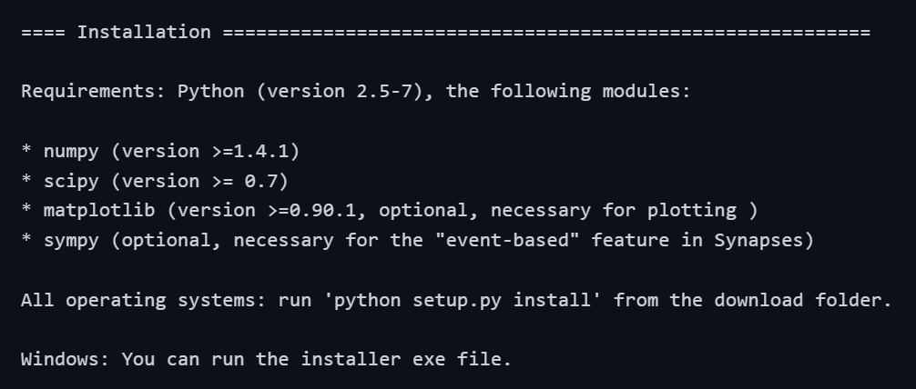
Requirements

Slide 3
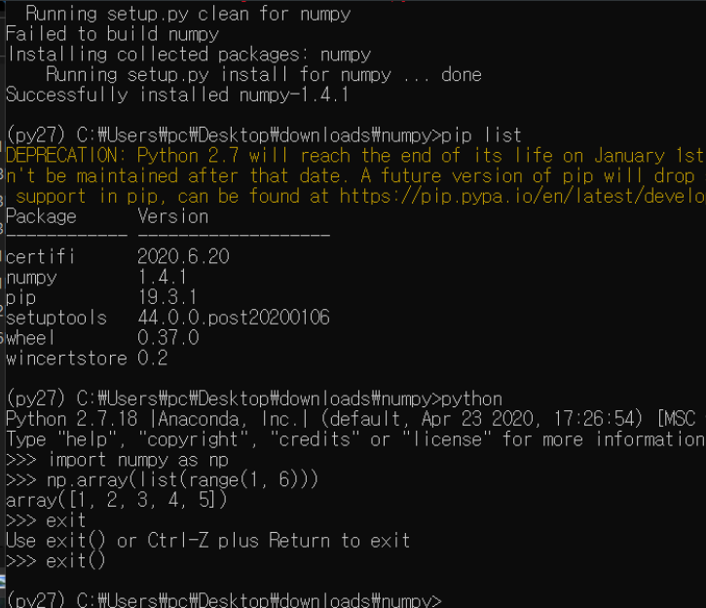
Anaconda3 – numpy old version

Slide 4
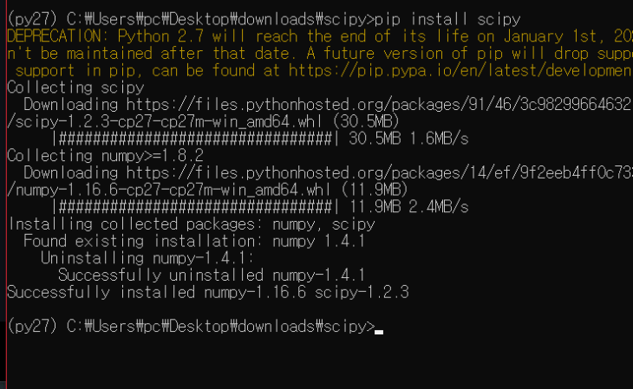
Anaconda3 – scipy 1.2 with numpy 1.8

Slide 5
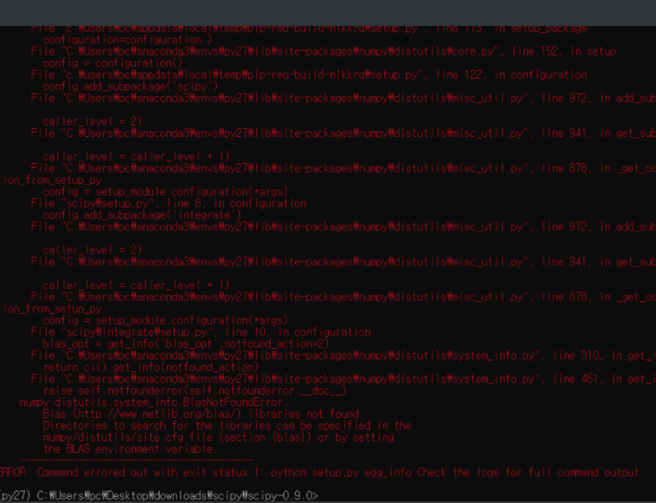
Anaconda3 – cannot install brian1

Slide 6
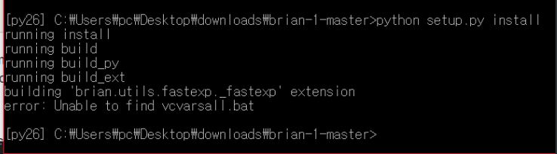
Anaconda2 – compiler error

Slide 7
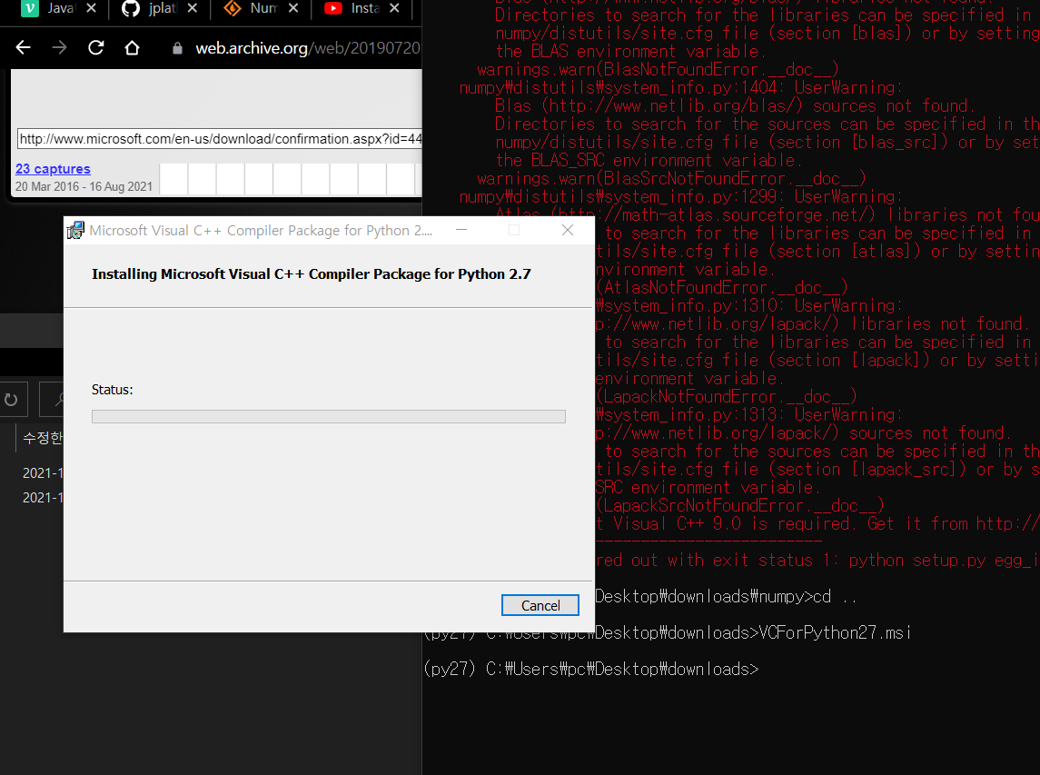

Slide 8
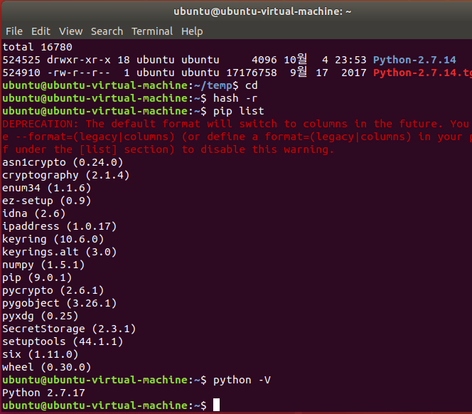
Ubuntu linux

Slide 9
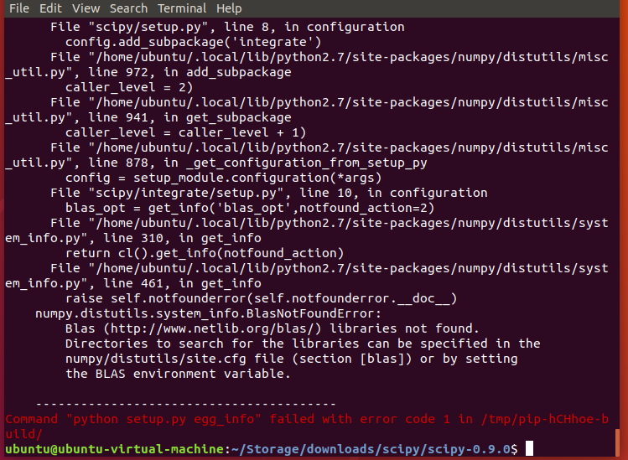
Ubuntu – scipy old version installation error

Slide 10
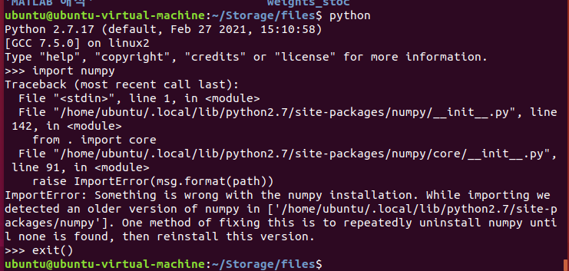
Ubuntu – numpy old version packages error

Slide 11
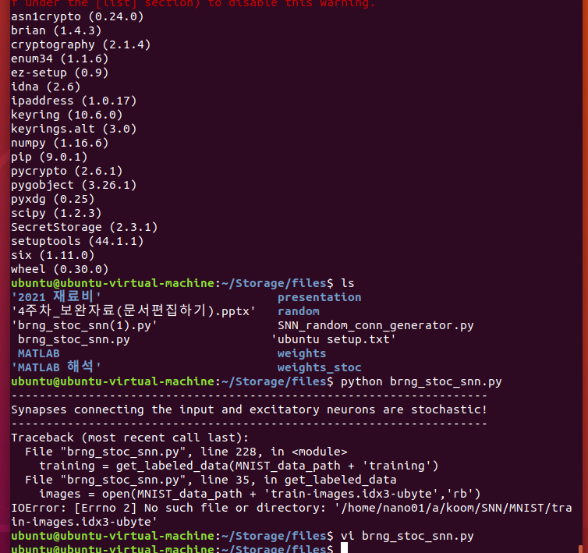
Ubuntu – numpy, scipy on python2.7

Slide 12
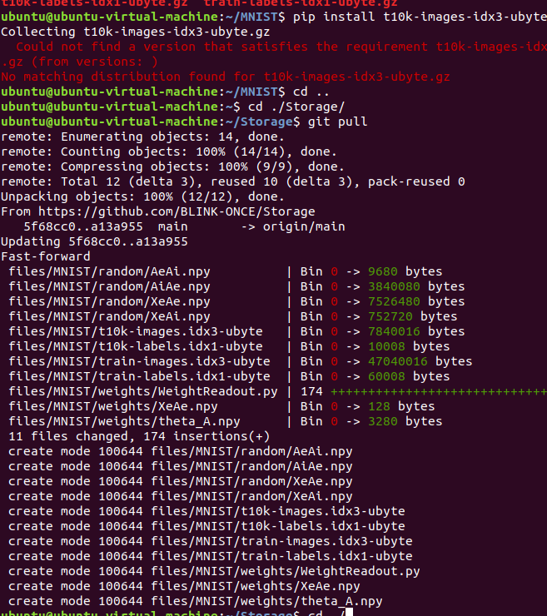
Ubuntu – loading MNIST datasets

Slide 13
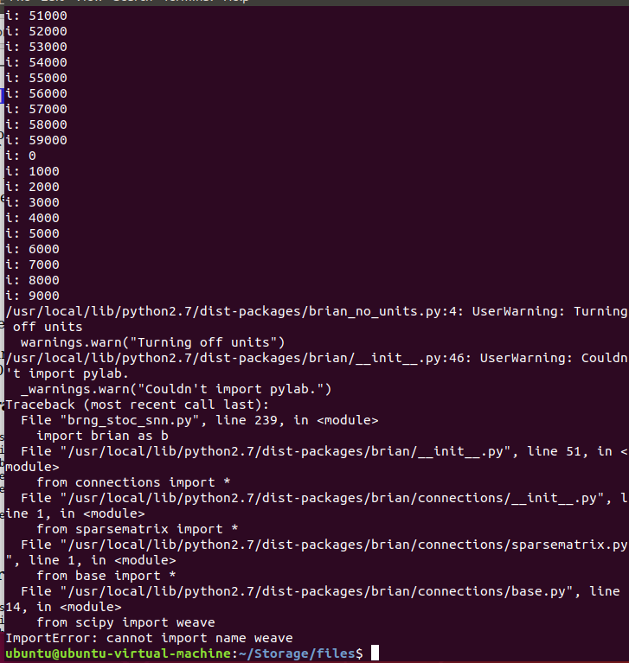
Ubuntu – running. Other errors.

